Slide 1
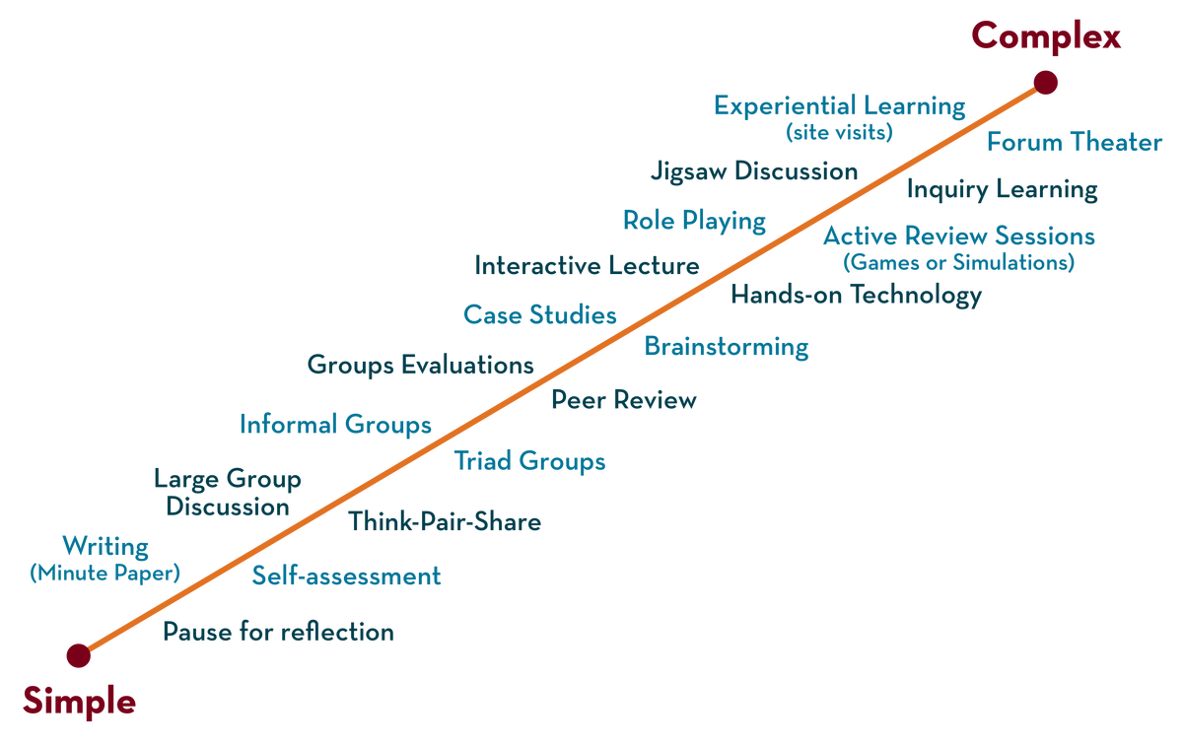
COURSE NAME : Operating Systems COURSE CODE: 21CS2109RA
CO2
Session - 2
SEGMENTATION, PAGING, ADDRESS TRANSLATION

Slide 2
AIM OF THE SESSION
To familiarize students with the basic concepts of Segmentation, Paging and Address Translation of Operating System
INSTRUCTIONAL OBJECTIVES
This Session is designed to:
Define Segmentation, Paging and Address Translation
Differentiate between Segmentation and Paging
List out the different types of Page Replacement Algorithms
Describe the role of Address Translation
A Case Study of Segmentation and paging in Operating Systems
LEARNING OUTCOMES
At the end of this session, you should be able to:
Defines Segmentation, Paging and Address Translation
Describe what page replacement algorithms do in operating systems
Summarize Role of an Page Replacement Algorithms .
A Comparative Study of different Page Replacement Algorithms FIFO, Optimal and LRU
A Case Study of Least Frequently Used and Most Frequently Used Page Replacement Algorithms

Slide 3
WHAT IS SEGMENTATION ?
A Segment can be defined as a logical grouping of Instructions such as a subroutine, array or a data area.
Every Program (job) is a collection of these segments.
Each job is divided into several segments of different sizes, one for each module that contains pieces that perform related functions

Slide 4
WHAT IS SEGMENTATION ?
Each Segment is actually a different logical address space of the Program
Segmentation is a memory management scheme which supports the programmer’s view of memory.
Programmers never think of their programs as a linear array of words.
Rather, they think of their programs as a collection of logically related entities such as subroutines or procedures, functions, global or local data areas, stacks etc.,

Slide 5
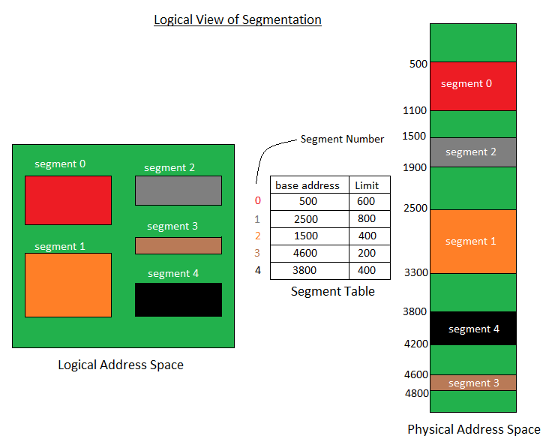
SEGMENTATION
A process is divided into Segments.
The chunks that a program is divided into which are not necessarily all the same sizes are called segments.
Segmentation gives user’s view of the process which paging does not give.
Here the user’s view is mapped to physical memory.

Slide 6
TYPES OF SEGMENTATION
Virtual memory segmentation Each process is divided into a number of segments, not all of which are resident at any one point in time.
Simple segmentation Each process is divided into a number of segments, all of which are loaded into memory at run time, though not necessarily contiguously.

Slide 7
TYPES OF SEGMENTATION
There is no simple relationship between logical addresses and physical addresses in segmentation. A table stores the information about all such segments and is called Segment Table.
Segment Table : It maps two-dimensional Logical address into one-dimensional Physical address. It’s each table entry has:
Base Address : It contains the starting physical address where the segments reside in memory.
Limit : It specifies the length of the segment.

Slide 8
ADVANTAGES OF SEGMENTATION
No Internal fragmentation.
Segment Table consumes less space in comparison to Page table in paging.

Slide 9
Disadvantages of Segmentation
As processes are loaded and removed from the memory, the free memory space is broken into little pieces, causing External fragmentation.

Slide 10
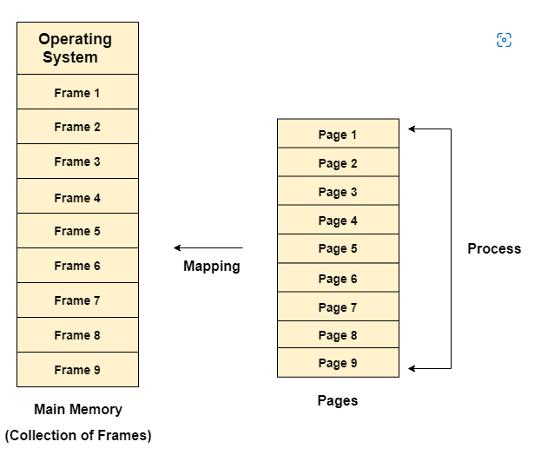
PAGING
Paging splits up address space into fixed-sized unit called a page.
With paging, physical memory is also split into some number of pages called a page frame.
Page table per process is needed to translate the virtual address to physical address

Slide 11
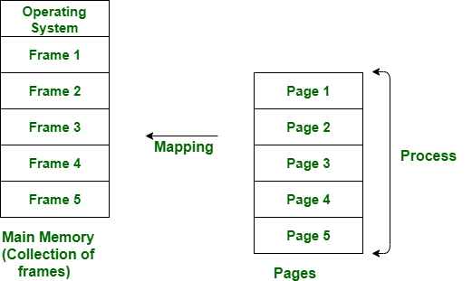
Paging is a storage mechanism used to retrieve processes from the secondary storage into the main memory in the form of pages.
The main idea behind the paging is to divide each process in the form of pages. The main memory will also be divided in the form of frames.

Slide 12
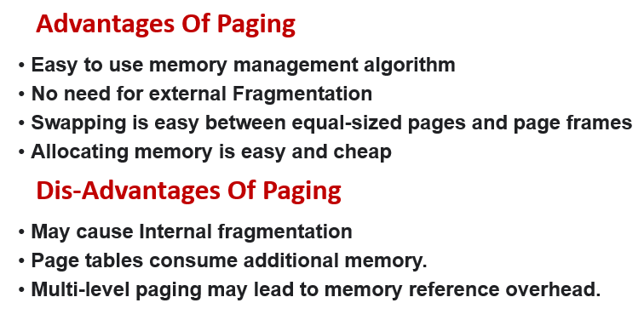
ADVANTAGES & DISADVANTAGES OF PAGING

Slide 13
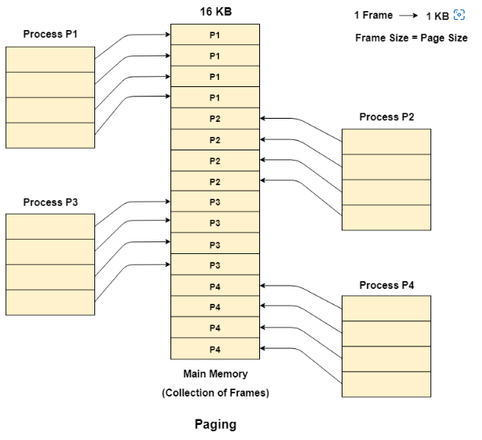
PAGING

Slide 14
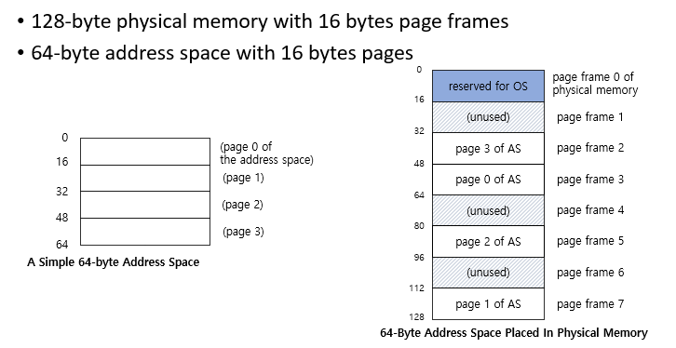
EXAMPLE : A SIMPLE PAGING

Slide 15
ADDRESS TRANSLATION
When a system allocates a frame to any page, It translates this logical address into a physical address and create entry into the page table to be used throughout execution of the Program.
When a process is to be executed, the corresponding pages are loaded into any available memory frames.

Slide 16
Address Translation in Virtual Memory
Whenever workloads access data in memory, the system needs to lookup the physical memory address that matches the virtual address.
This is what were refer we refer to as memory translations or mappings.
To map virtual memory addresses to physical memory addresses, page tables are used.

Slide 17
Address Translation in Paging
The address translation in paging in Operating Systems is an address space that is the range of valid addresses available in a program or process memory.
It is the memory space accessible to a program or process.
The memory can be physical or virtual and is used for storing data and executing instructions.
The two main types of address space are logical address space and physical address space.

Slide 18
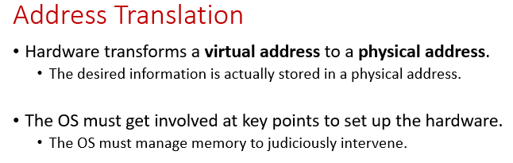
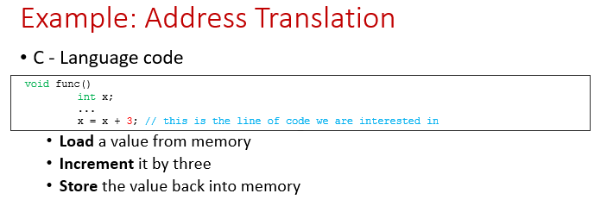

Slide 19
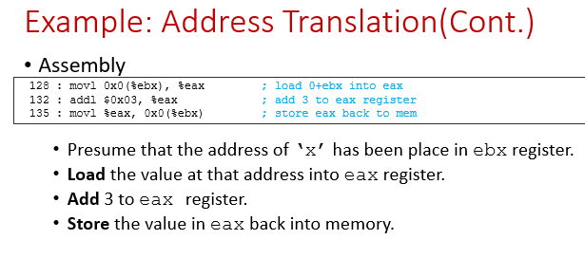

Slide 20
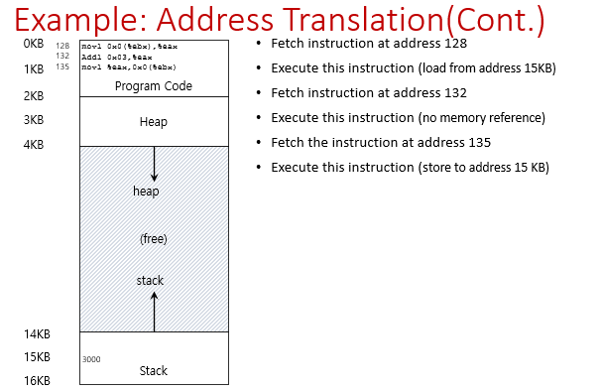

Slide 21
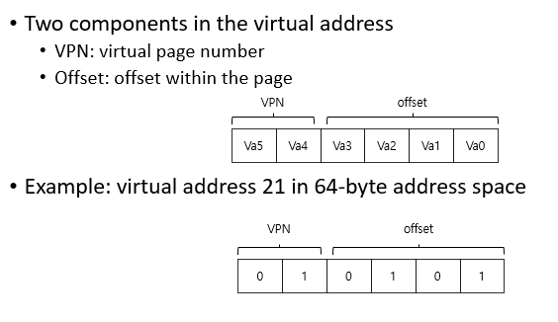

Slide 22
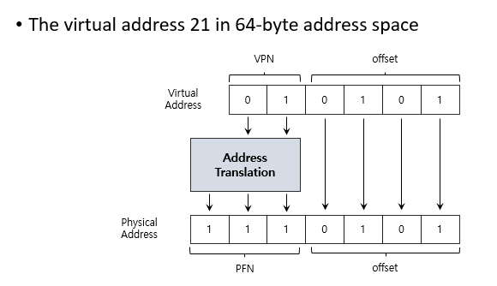
EXAMPLE OF ADDRESS TRANSLATION

Slide 23
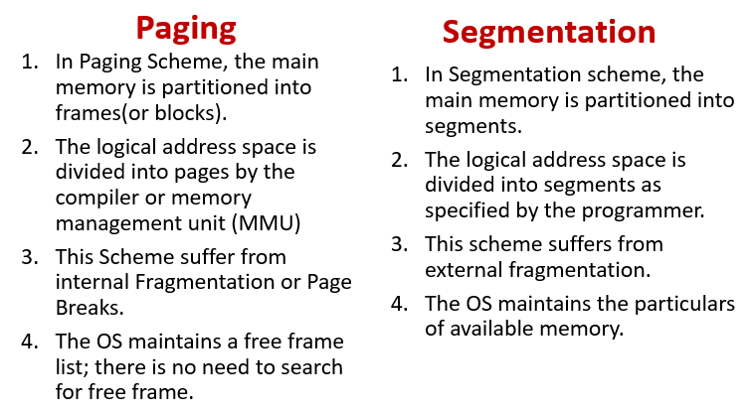
DIFFERENCE BETWEEN PAGING AND SEGMENTATION

Slide 24
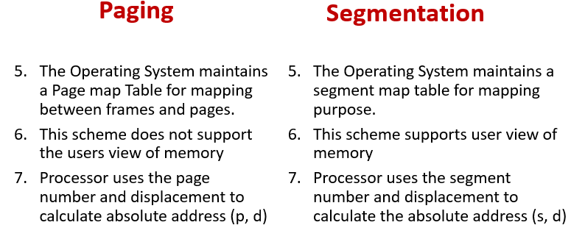

Slide 25
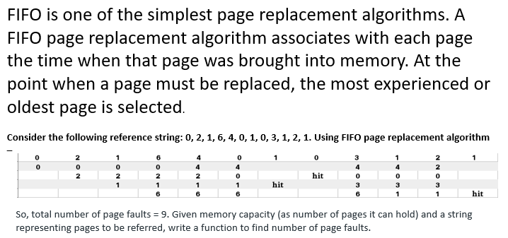
Page Replacement Algorithm – First In First Out (FIFO)

Slide 26
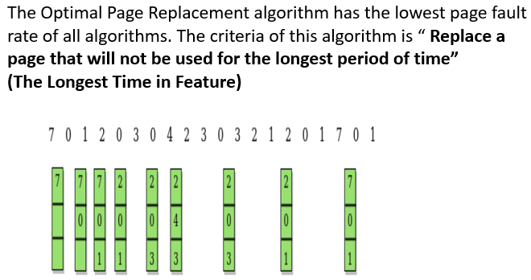
Page Replacement Algorithm – Optimal Page Replacement Algorithm

Slide 27
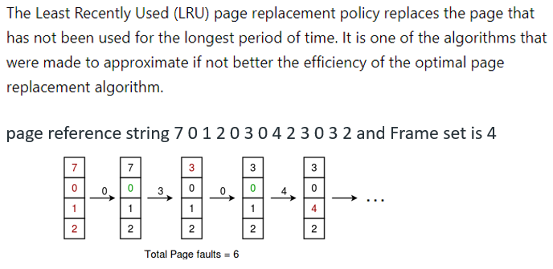
Page Replacement Algorithm – Least Recently Used (LRU)

Slide 28
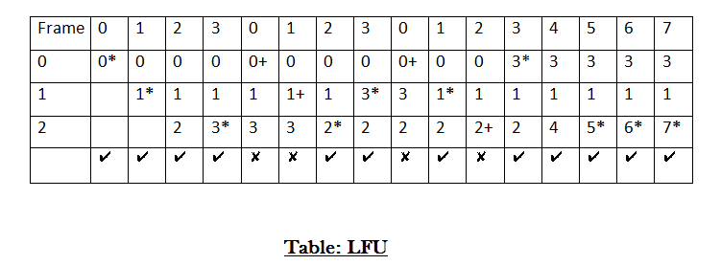
Page Replacement Algorithm – Least Frequently Used (LFU)
The Least Frequently used algorithm “Selects a page for replacement, if the page has not been used often in the past” or “Replace page that page has smallest count”

Slide 29
Page Replacement Algorithm – Most Frequently Used (MFU)
The Most Frequently used algorithm “Selects a page for replacement, if the page has been used often in the past” or “Replace page that page has highest count”

Slide 30
ACTIVITIES/ CASE STUDIES/ IMPORTANT FACTS RELATED TO THE SESSION
When do Page Faults Occur? Describe the actions taken by the O.S when a Page Fault Occurs
Consider the following page-reference string – 7, 0, 1, 2, 0, 3, 0, 4, 2, 3, 0, 3, 2, 1, 2, 0, 1, 7, 0, 1. How many page faults would occur for the following page replacement algorithms, assuming 3 frames:- FIFO, Optimal, LRU
Compare the following page replacement algorithms using one example: FIFO, LRU, Optimal algorithms
How many page faults would occur for the following reference string for four page frames using LRU algorithm 1, 2, 3, 4, 5, 3, 4, 1, 6, 7, 8, 7, 8, 9, 7, 8, 9, 5, 4, 5, 4, 2.
How many page faults occur for Least Frequently Used and Most Frequently Used for the reference string 0, 1, 2, 3, 0,1, 2, 3, 0, 1, 2, 3, 4, 5, 6, 7 with 3 memory frames.

Slide 31
TERMINAL QUESTIONS
What is Segmentation ? Discuss Advantages and Disadvantages of Segmentation.
Explain about Paging and Different Page Replacement Algorithms?
Discuss in detail about Address Translation along with proper Examples
Differentiate between Segmentation and Paging
Consider the following page reference string:
1, 2, 3, 4, 2, 1, 5, 6, 2, 1, 2, 3, 7, 6, 3, 2, 1, 2, 3, 6
How many pages faults would occur for the following replacement algorithms, assuming one, two, three, four, five, six or seven frames? Remember all frames are initially empty, so unique pages will all cost one fault each.
a) LRU replacement b) FIFO replacement c) optimal replacement.

Slide 32
SUMMARY
Segmentation is a memory management scheme which supports the programmer’s view of memory. Programmers never think of their programs as a linear array of words. Rather, they think of their programs as a collection of logically related entities such as subroutines or procedures, functions, global or local data areas, stacks etc.,
Paging splits up address space into fixed-sized unit called a page. With paging, physical memory is also split into some number of pages called a page frame. Page table per process is needed to translate the virtual address to physical address.
FIFO is one of the simplest page replacement algorithms. A FIFO page replacement algorithm associates with each page the time when that page was brought into memory. At the point when a page must be replaced, the most experienced or oldest page is selected.

Slide 33
SUMMARY
The Optimal Page Replacement algorithm has the lowest page fault rate of all algorithms. The criteria of this algorithm is “ Replace a page that will not be used for the longest period of time” (The Longest Time in Feature)
The Least Recently Used (LRU) page replacement policy replaces the page that has not been used for the longest period of time. It is one of the algorithms that were made to approximate if not better the efficiency of the optimal page replacement algorithm.
The Least Frequently used algorithm “Selects a page for replacement, if the page has not been used often in the past” or “Replace page that page has smallest count.
The Most Frequently used algorithm “Selects a page for replacement, if the page has been used often in the past” or “Replace page that page has highest count”
Address Translation: Hardware transforms a virtual address to a physical address.
The OS must get involved at key points to set up the hardware.
The desired information is actually stored in a physical address.
The OS must manage memory to judiciously intervene.

Slide 34
Replace a page that has not been used for the longest period of time is the criteria of which of these algorithms
FIFO
LRU
Optimal
None of the above
Replace a page that is the oldest page of all the pages of main memory?.
FIFO
LRU
Optimal
None of the above

Slide 35
REFERENCES FOR FURTHER LEARNING OF THE SESSION
Reference Books:
1. Arpaci-Dusseau, Remzi H., and Andrea C. Arpaci-Dusseau. Operating systems: Three easy pieces. Boston: Arpaci-Dusseau Books LLC, 2018. http://pages.cs.wisc.edu/~remzi/OSTEP/
Silberschatz, Abraham, Peter B. Galvin, and Greg Gagne. Operating system concepts. 10th edition, John Wiley & Sons, 2018.
Tanenbaum, Andrew. Modern operating systems. Pearson Education, Inc., 2009.
Sites and Web links:
https://www.cse.iitb.ac.in/~mythili/os/
https://cse.iitkgp.ac.in/~sumantra/courses/os/os_pg.html
https://www.cse.iitd.ernet.in/os-lectures

Slide 36

THANK YOU
Team – Operating System

